Slide 1




COVIDSIMVL
February 4, 2021
Ernie Chang, MD PhD
Ken Moselle, PhD Island Health

Slide 2
GOALS today
20 minutes
Overview for what it is and is not
Some controls and metrics
Short demonstration in vaccine space
Q&A

Slide 3
Challenges we worked on
Herd immunity trials
Multiverse with LTC, school, bar and HOME
Contact tracing reducing infectious days in community
UK virus – what does 70% mean
Pfizer, Moderna and Hybrid vaccinations compared
Simulation based on Cluster in Childcare Centre
Age-Based vaccination schedule exploration

Slide 4
Simulation model for Covid-19
Agent-based with physical moves
Built-in viral temporal dynamics Xi [Nature Medicine]
Sandbox with controls and data collection
Conduct “clinical trials” and scenarios
Tools and metrics

Slide 5
State Changes
Transmission
susceptibles
Incubating
Fixed arena
Overlap is contagion
Size affected by viral load
HzR = hazard radius
Movements stochastic
mF = mingle factor
symptomatic
pre-symptomatic or
asymptomatic transmitter
Inert – recovered, isolated, deceased

Slide 6
“Temporal dynamics in viral shedding and transmissibility of COVID-19”
Nature Medicine Aug 7 2020. Xi He, Eric HY Lau et al.
Susceptible
Incubating
Pre-symptomatic
Symptomatic
INERT
Infected
INFECTIOUS
onset
critical
Peak Viral Load
?? Approach
Use susc?
serious
3.0d
mild
T=0
2.2d
5.2d
13.2d
VIRAL LOAD AFFECTS SIZE → TRANSMITTABILITY

Slide 7
Simulation framework
Not predictive
Agent-based
Scenario exploration
Sandbox for detailed study
Control of data collection
Control of parameters
Monte Carlo – propose move
from Pareto distribution
Markov Chain – agent infection
function of previous
[MCMC] microSimulation
smaller population instead
of whole

Slide 8
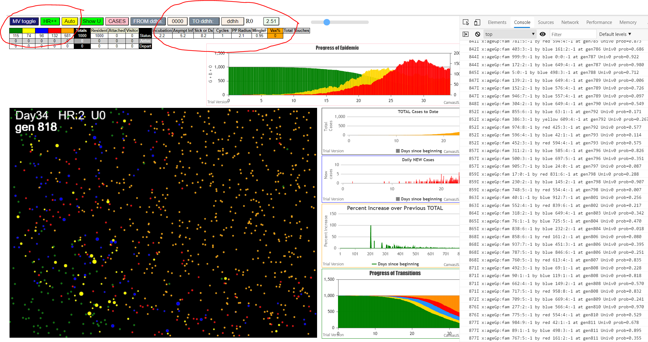
Fixed Universe
Status, controls, console log, visual displays

Slide 9
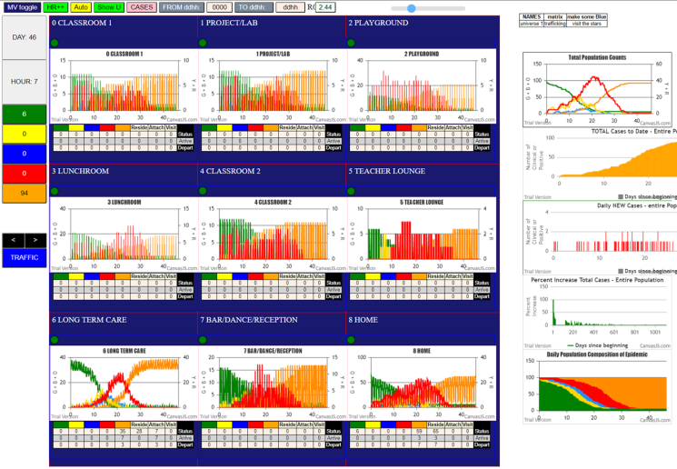
The Multiverse Model

Slide 10
Some Metrics
Epidemic intensity – size and mingling
THETA – time between infections within a time frame
Transmission Trees

Slide 11
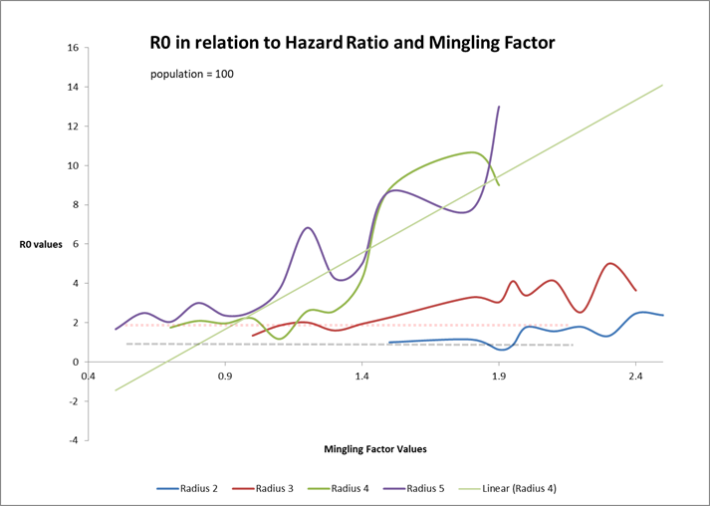

Slide 12
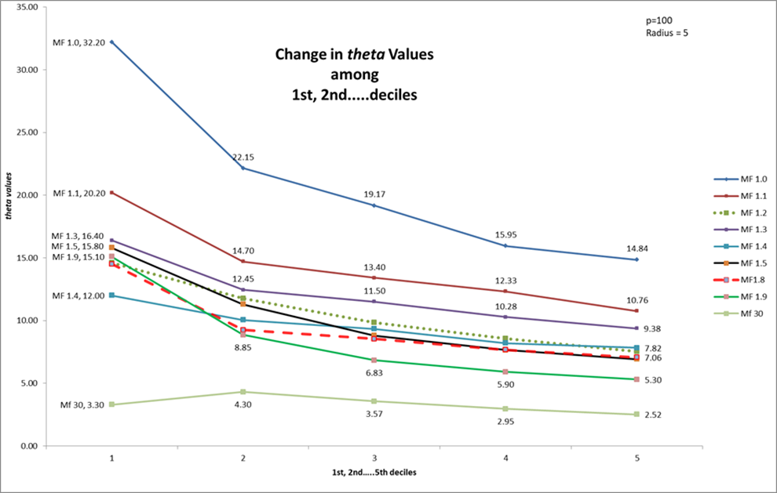
Theta – time in generations between successive infections in a time frame
Time frame – generations to 10% - 20% - 30% - 40% etc of infections

Slide 13
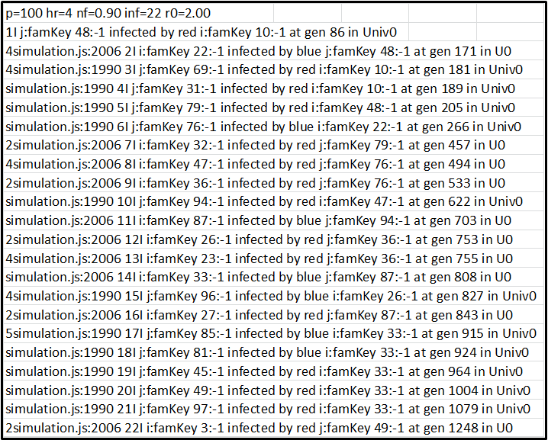
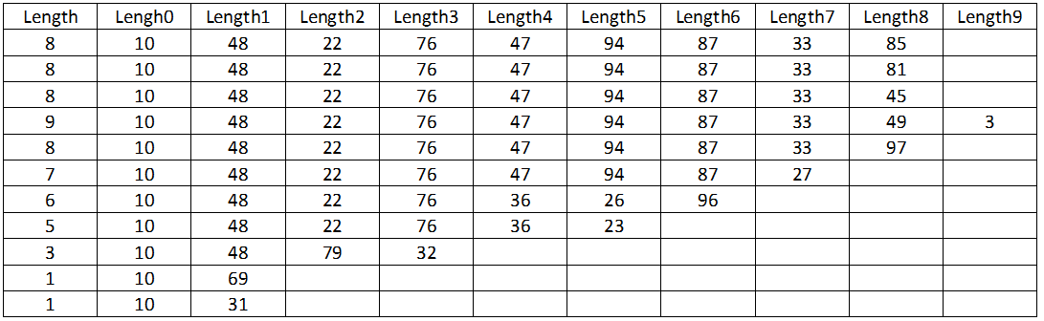
FROM CONSOLE.LOG
to
EXCEL SPREADSHEET

Slide 14
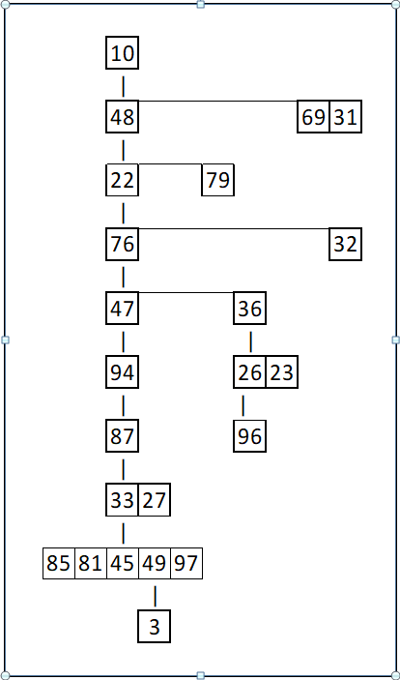
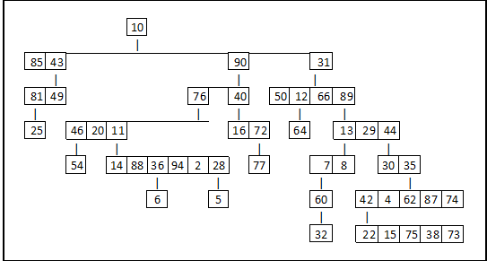
TRANSMISSION TREES
narrow, long skinny tree
slow spread
Q value = 3.33
shallow, wide tree
many simultaneous transmitters
Q value = 41.36
Q-value is derived metric incorporating
depth, generations, number of nodes and leaves
CovidSIMVL --Transmission Trees, Superspreaders and Contact Tracing in Agent Based Models of Covid-19
Ernie Chang, Kenneth A. Moselle, Ashlin Richardson
doi: https://doi.org/10.1101/2020.12.21.20248673 medrxiv.org

Slide 15
projects
Herd immunity trials
Multiverse with LTC, school, bar and HOME
Contact tracing reducing infectious days in community
UK virus – what does 70% mean
Pfizer, Moderna and Hybrid vaccinations compared
Simulation based on Cluster in Childcare Centre
Age-Based vaccination schedule exploration

Slide 16
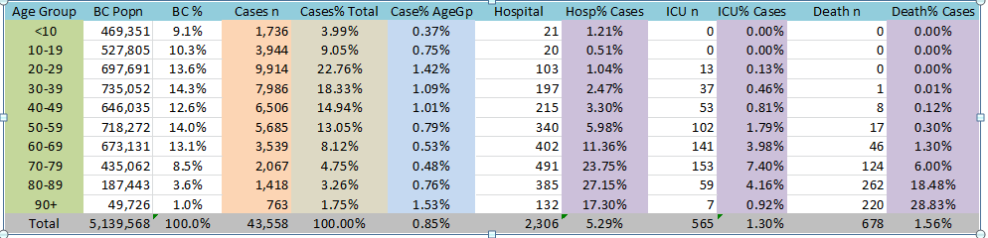
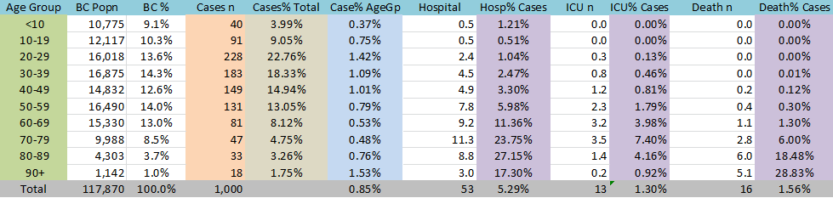
BCCDC Jan – Dec 2020 Covid statistics
Consider this a clinical exploration (microSimulation) of 1,000 infected cases
We set parameters so that all are infected (margin of stochasticity)
Then we apply vaccinations to see the impact

Slide 17
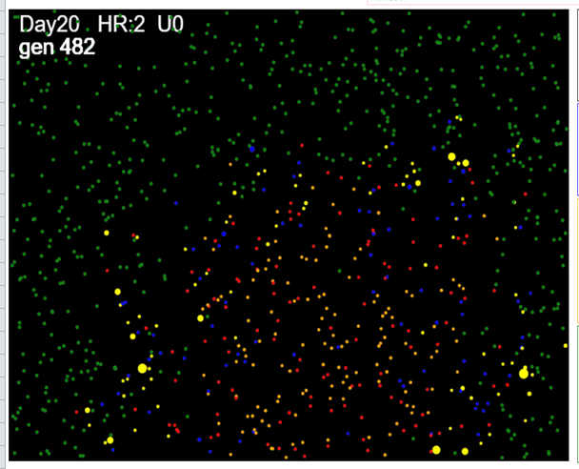
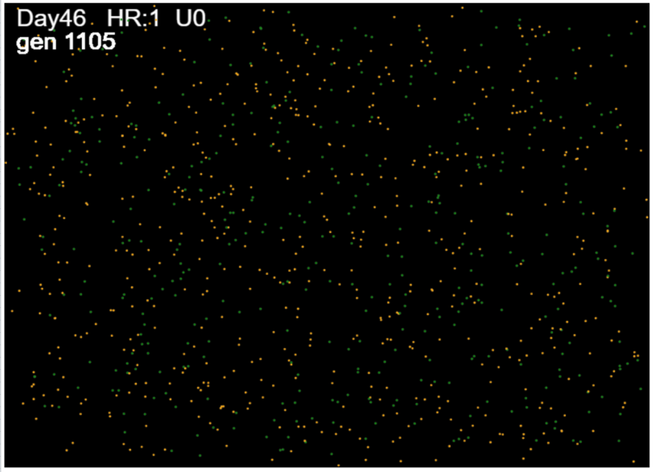
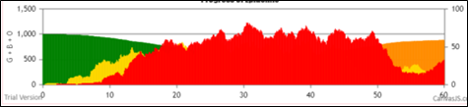
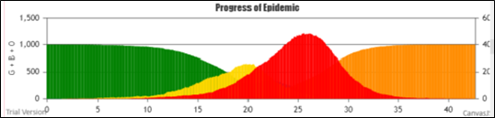
WAVE vs PARTICLE dynamics
Parameters minimize mingle
Parameters emphasize mingle
Takes longer but truncated the bell curve
Typical exponential growth
Does restricting movement convert exponential to polynomial growth?

Slide 18
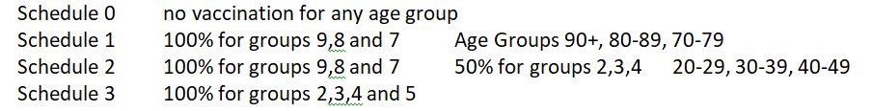
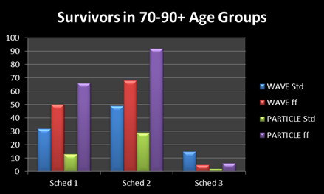
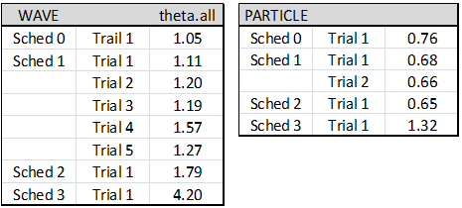
Vaccination schedules
0%
75%
95%
T.v
+14
+28
Trials for WAVE and PARTICLE dynamics

Slide 19
DEMO
Q&A

Slide 20
some next steps in tool development
Integrate CovidSIMVL with R
Javascript + html runs on modern web browsers
Automate repeated runs and data collection
Automate analysis – theta, transmission trees, etc
Implement goal-directed parameter setting in R
Correlate simulation with equation-based methods
NEXT

Slide 21
CovidSIMVL
Case Data per day
Equation based model
Coefficients
Match to CovidSIMVL
parameters
IRL case data
https://github.com/ecsendmail/MultiverseContagion

